Slide 1
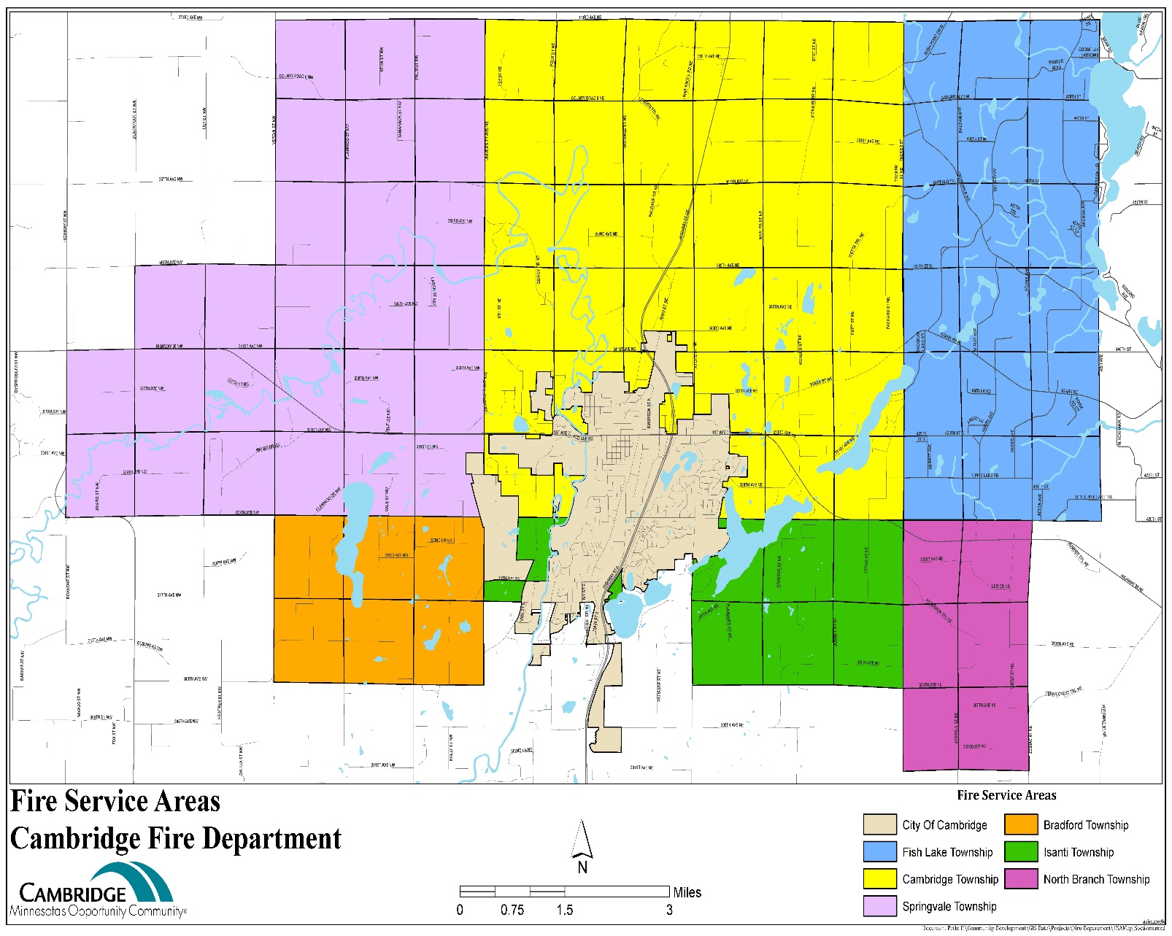
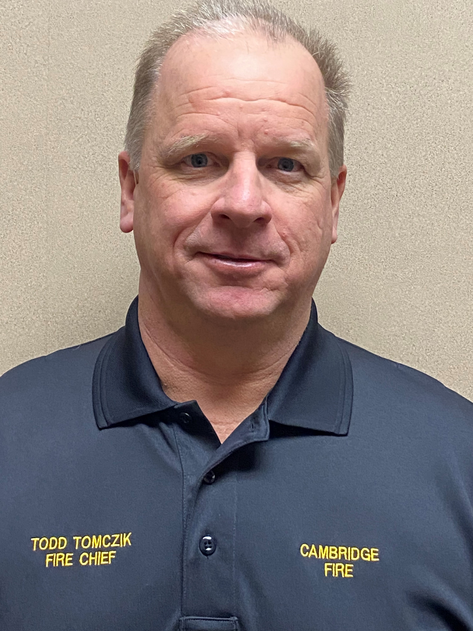
Cambridge Fire
103 Square Miles of Fire Protection Area.
Serving:
City of Cambridge
Cambridge Township
Bradford Township
Fish Lake Township
Isanti Township
North Branch Township
Springvale Township

Slide 2
Cambridge Fire 2022

Slide 3
Staff

Slide 4
2022
Second year of Todd Tomczik as Chief
Truck Committee still working on Engine Replacement. (E4)
Discontinued Par 360 for Firefighter health and well being.
Spouses and significant others group still active and leading a great effort.
Wind down of COVID 19,20,21 and 22 as Chief Tomczik calls it.
Obtained Wild Land PPE
3 of the 4 new members brought on in Feb. 22 now done with FF1, 2 and EMR.
Increased Medical Runs.

Slide 5
2022
Members participated in over 399 volunteer hours helping at various community events.
Brought the Open House back after 2 years of COVID
Splash Pads
Working on Pre Planes on I am Responding
EMR training with challenges
School Fire Prevention Education
Many Other Community events

Slide 7
Changes in Time and Focus
Fire Department commitment has changed over the years. Minimum time for new firefighter training has increased from 46 hours in 1997 to 200 hours in 2022. Not only has initial training increased, but continued education requirements nearly doubled. In 2018, new hires need to take:
140 Hours of training (FF 1 and FF2)
30 Hours of Hazardous Materials Operations included in FF2
Emergency Medical Responder (40 hours).
Drivers Training (20 hours)
This time commitment and the change in generational dynamics reflects the challenges with firefighter recruitment and retention we face in Cambridge, in Minnesota and around the Nation. It is critical to have firefighters that are willing to dedicate the time necessary to respond 24/7/365 when the pager goes off.

Slide 8
Services Delivered
The Cambridge Fire Department is proud of the diversified service we deliver. Whether it is helping a victim on the river to a simple lift assist the Department will always lend a hand to those in need.
Fire suppression
Fire safety prevention and education
Extrication
Technical Rescue (High - Low Angle and Confined Space)
Water Rescue
Hazardous Materials Response
Emergency Medical Response
Pre planning
Fire Inspections

Slide 9
Calls 2018 thru 2022

Slide 10
Calls for Service Per Municipal/Township

Slide 11
2022 Fire Calls by Type

Slide 12
Rescue Calls by Type

Slide 13
Looking Forward
Increased Paid on-call rate attempting to avoid Duty Crews and Full time staffing.
Maintain Staffing Levels.
Plan for Equipment purchasing by evaluating Capital Plan annually.
Completer Pre incident planning and import to I am Responding for all member access and to maintain good ISO rating.
Continue a focus on Firefighter Health and Well being.
Continue to assist in keeping budget in check with fundraising and grant opportunities.

