Slide 1
City of Cambridge
Finance & Housing Department Update
February 2022

Slide 2
Distinguish between update for Feb 22, 2022 and May 2, 2022
February 22, 2022
Update on “Operations” of Finance Department
May 2, 2022 (expected date)
Update on City of Cambridge Financial Condition with Presentation by External Auditor
Highlight members of Finance Team
Review functions performed by Finance Team
Review selected workload statistics
Financial Statement Review
Legal Compliance Review
Federal Spending Review

Slide 3
Finance & Housing Team
Caroline Moe
Director of Finance
Hired 2/4/2002
Linda Gerlach
Finance Clerk
Hired 7/23/2012
Joleen Kriesel
Utility Billing Clerk & Revenue Specialist Hired 10/31/1988
Machelle Bruss
Afternoon receptionist Hired 6/12/2018
Deb Barrett
Housing Supervisor
Hired 10/5/2016

Slide 4
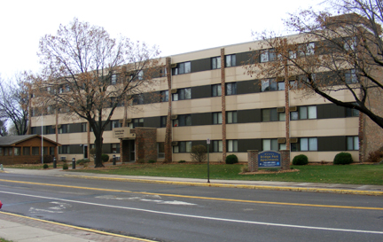
Finance Department
The Finance Department is responsible for the fiscal management
and processing all accounting transactions for the City.
Department responsibilities include:
Financial policies and procedures
Payroll
Accounts receivable / Accounts Payable
Utility billing
Budgeting / Long-range financial planning
Audit Coordination
Investment management
Fixed asset management
Information systems, insurance and many personnel functions
Housing Department
The Housing Department operates Bridge Park Apartments at 121 South Fern Street. Bridge Park has 45 apartments. Bridge Park is funded by operating and capital fund subsidies from the US Department of Housing and Urban Development along with rent payments from tenants.

Slide 5
Utility Billing Information
Delinquent Account Statistics—note in 2020 due to COVID, collection procedures were suspended from April-August.
Accounts Billed Per Month
(using August of each year for comparative purposes)

Slide 6
Accounts Payable & Payroll Information
Note—dollar value can fluctuate substantially depending on capital project activity as well as debt retirement.
Note—while the dollar value of disbursement activity fluctuates, the total number of disbursements processed each year has been fairly consistent.

Slide 7
Other Important Finance Dept Info
The City has had “clean audit reports” and received the GFOA Certificate of Achievement for Excellence in Financial Reporting since 2002.
Bond Rating--Standard and Poor’s, an independent rating company, has improved the City’s bond rating citing what they describe as strong financial management practices, budget flexibility and liquidity. A strong bond rating is important as it helps us attract more bidders for our bond sales. When we have more bidders for our bonds, the competitive market forces work in our favor to help us receive lower interest rates, helping us control future tax and utility rate increases.
The City strives to be transparent with its financial matters. For more information, visit the City’s website at www.ci.cambridge.mn.us
Year | Cambridge Bond Rating
2002 | A-
2008 | A+
2010 | AA-
2014-2021 | AA

